Slide 2
T-SQL and Relational Database

Slide 3
Core Concepts

Slide 4
DBMS
Software package for defining and managing a database.
Relational Database and Non-Relational Database
Structured Data vs Semi-Structured Data vs Unstructured Data
Transactions
ACID principle
atomicity -> all or nothing
consistency -> does not violate integrity/constraints
isolation -> different transactions are isolated
durability -> permanent records
Descriptive relations(one to one, ...)
Relational Integrity(PK/FK)

Slide 5
DBMS
OLTP, OLAP (DW) (Online Transaction/analytical Processing)
ODS - operational data store
Data Lake

Slide 6
SQL Server
On Premise vs On Cloud
SQL Server Software on IaaS or PaaS, SaaS
Integration - SSIS
Visualization & Analytics - SSAS, SSRS

Slide 7
Terms in SQL Server
Server Instance
Database
System databases: master, resource, model, tempdb, msdb
Files:
.mdf: Primary Data File
only one, stores objects like tables, views, SPs, functions…
.ndf: Secondary Data File
holds additional data, might not be present.
ldf: Log File
Schema, Objects
Identity Column
default is to start at 1, and increment by 1 for each record
Surrogate key vs natural key

Slide 8
Normalization
Normalization is mostly done in OLTP to ensure data integrity and saving storage space
1NF: Unique rows, unique keys, no comma separated values(atomic values)
2NF: Non key value should dependent on Candidate Key
3Nf: Repeated values out for a relationship
Normalization in DW: mix of star and snowflake, Fact Table and Dimension Table

Slide 9
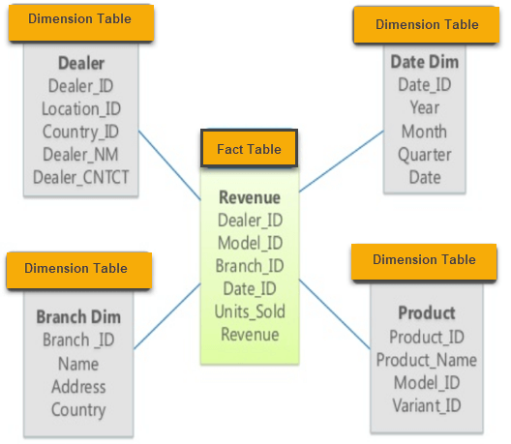
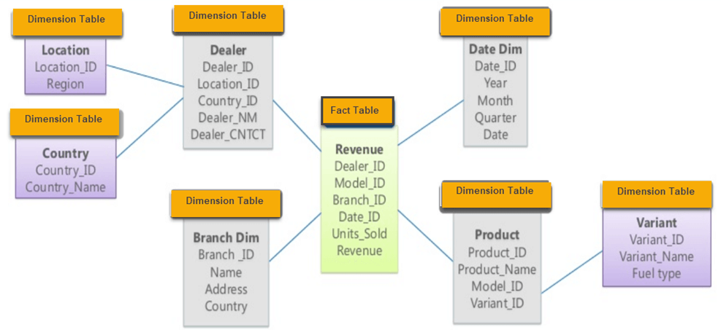
Data Warehouse Schemas
Star vs Snowflake

Slide 10
Data Warehouse Schemas
Star vs Snowflake
Star Schema | Snowflake Schema
Hierarchies for the dimensions are stored in the dimensional table. | Hierarchies are divided into separate tables.
It contains a fact table surrounded by dimension tables. | One fact table surrounded by dimension table which are in turn surrounded by dimension table
In a star schema, only single join creates the relationship between the fact table and any dimension tables. | A snowflake schema requires many joins to fetch the data.
Simple DB Design. | Complex DB Design.
Denormalized Data structure and query also run faster. | More Normalized Data Structure.
High level of Data redundancy | lower level of data redundancy
Single Dimension table contains aggregated data. | Data Split into different Dimension Tables.

Slide 11
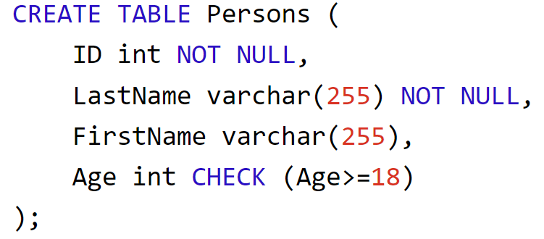
Constrains
PK: Only one per table, unique, not null, not necessary, physically sorts data
“Composite” keys: PK made up from multiple columns
UK: multiple per table, unique, one null per column allowed
FK: PK from another table
Action: cascade, set null, set default, no action
A single table can use it’s own PK as FK. eg. emp table, emp_id, manager_id
Check
Not NULL

Slide 12
Data Types In SQL Server - String
Data type | Description | Max size | Storage
char(n) | Fixed width character string | 8,000 characters | Defined width
varchar(n) | Variable width character string | 8,000 characters | 2 bytes + number of chars
varchar(max) | Variable width character string | 1,073,741,824 characters | 2 bytes + number of chars
text | Variable width character string | 2GB of text data | 4 bytes + number of chars
nchar | Fixed width Unicode string | 4,000 characters | Defined width x 2
nvarchar | Variable width Unicode string | 4,000 characters
nvarchar(max) | Variable width Unicode string | 536,870,912 characters
ntext | Variable width Unicode string | 2GB of text data
binary(n) | Fixed width binary string | 8,000 bytes
varbinary | Variable width binary string | 8,000 bytes
varbinary(max) | Variable width binary string | 2GB
image | Variable width binary string | 2GB

Slide 13
Data Types In SQL Server - Numeric
Data type | Description | Storage
bit | Integer that can be 0, 1, or NULL
tinyint | Allows whole numbers from 0 to 255 | 1 byte
smallint | Allows whole numbers between -32,768 and 32,767 | 2 bytes
int | Allows whole numbers between -2,147,483,648 and 2,147,483,647 | 4 bytes
bigint | Allows whole numbers between -9,223,372,036,854,775,808 and 9,223,372,036,854,775,807 | 8 bytes
decimal(p,s) | Fixed precision and scale numbers. Allows numbers from -10^38 +1 to 10^38 –1. The p parameter indicates the maximum total number of digits that can be stored (both to the left and to the right of the decimal point). p must be a value from 1 to 38. Default is 18. The s parameter indicates the maximum number of digits stored to the right of the decimal point. s must be a value from 0 to p. Default value is 0 | 5-17 bytes
numeric(p,s) | Fixed precision and scale numbers. Allows numbers from -10^38 +1 to 10^38 –1. The p parameter indicates the maximum total number of digits that can be stored (both to the left and to the right of the decimal point). p must be a value from 1 to 38. Default is 18. The s parameter indicates the maximum number of digits stored to the right of the decimal point. s must be a value from 0 to p. Default value is 0 | 5-17 bytes
smallmoney | Monetary data from -214,748.3648 to 214,748.3647 | 4 bytes
money | Monetary data from -922,337,203,685,477.5808 to 922,337,203,685,477.5807 | 8 bytes
float(n) | Floating precision number data from -1.79E + 308 to 1.79E + 308. The n parameter indicates whether the field should hold 4 or 8 bytes. float(24) holds a 4-byte field and float(53) holds an 8-byte field. Default value of n is 53. | 4 or 8 bytes
real | Floating precision number data from -3.40E + 38 to 3.40E + 38 | 4 bytes

Slide 14
Data Types In SQL Server - Time
Data type | Description | Storage
datetime | From January 1, 1753 to December 31, 9999 with an accuracy of 3.33 milliseconds | 8 bytes
datetime2 | From January 1, 0001 to December 31, 9999 with an accuracy of 100 nanoseconds | 6-8 bytes
smalldatetime | From January 1, 1900 to June 6, 2079 with an accuracy of 1 minute | 4 bytes
date | Store a date only. From January 1, 0001 to December 31, 9999 | 3 bytes
time | Store a time only to an accuracy of 100 nanoseconds | 3-5 bytes
datetimeoffset | The same as datetime2 with the addition of a time zone offset | 8-10 bytes
timestamp | Stores a unique number that gets updated every time a row gets created or modified. The timestamp value is based upon an internal clock and does not correspond to real time. Each table may have only one timestamp variable

Slide 15
Data Types In SQL Server - Other
Data type | Description
sql_variant | Stores up to 8,000 bytes of data of various data types, except text, ntext, and timestamp
uniqueidentifier | Stores a globally/universally unique identifier (GUID/UUID)
xml | Stores XML formatted data. Maximum 2GB
cursor | Stores a reference to a cursor used for database operations
table | Stores a result-set for later processing

